Slide 1
Are your customers happy?
MATH5470 Final Project
DENG Yizhe, HUANG Yifei, SUN Jiaze, WANG Jingming

Slide 2


Slide 3

A British bank
One of the largest in the UK

Slide 4

Objective
Identify the dissatisfied customers (before it’s too late)
Binary classification

Slide 5
The Data
76,020 samples
73,012 satisfied – Class 0
3,008 dissatisfied – Class 1
369 anonymized features

Slide 7
Solutions?
Data Level
Over-sampling
Under-sampling
Algorithm level
Class weight
New models

Slide 8
Data Pre-processing

Slide 9
Data Cleaning
50 features
repeated
or
constant
369 features
319 features

Slide 10
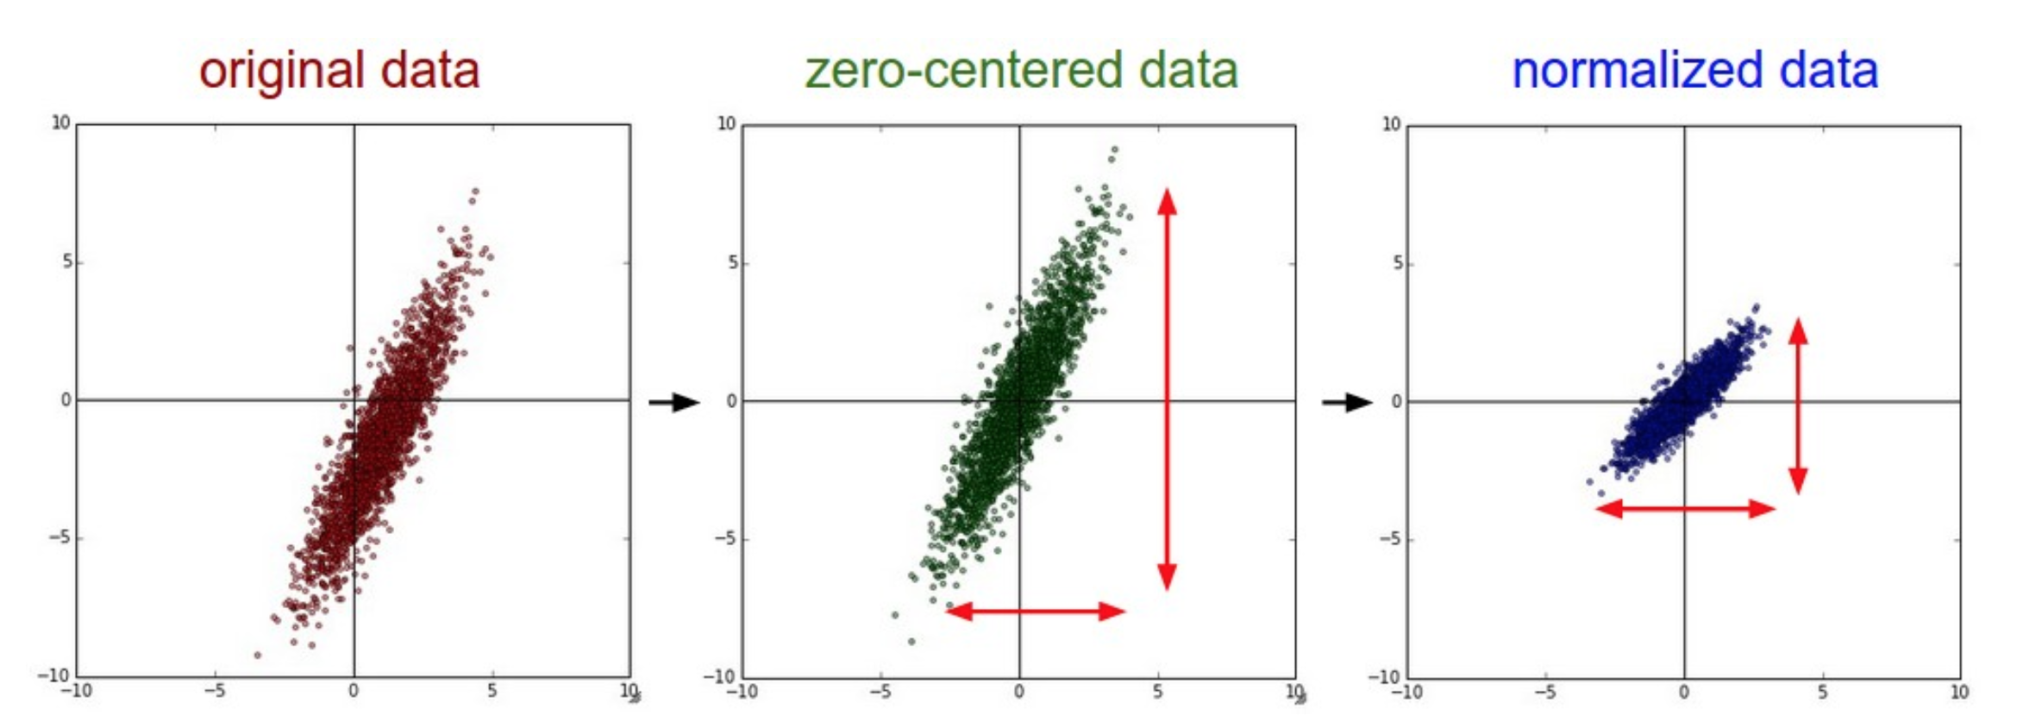
Normalization
(Synthetic data, for illustration only)
Retrieved: http://cs231n.github.io/neural-networks-2/

Slide 11
Visualization & Clustering

Slide 12
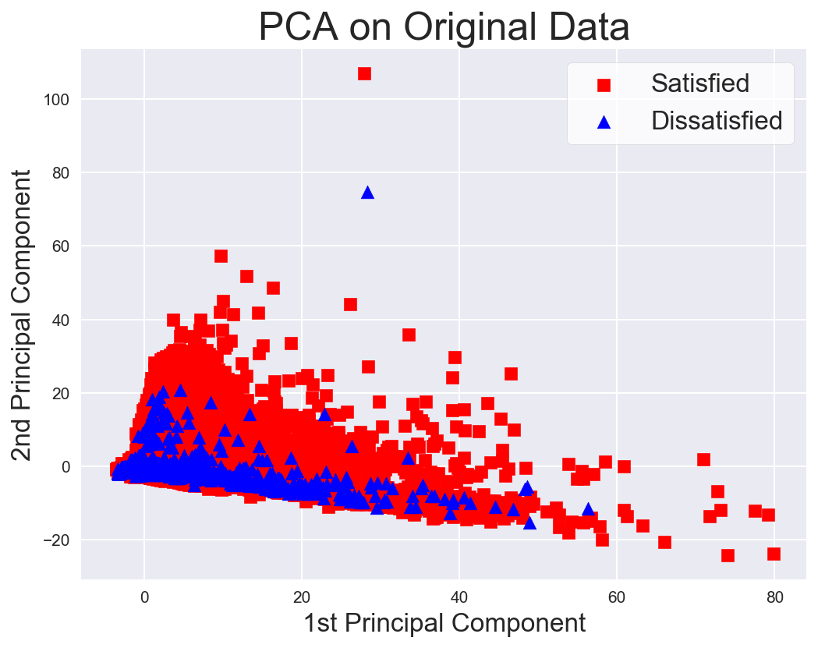

Slide 13
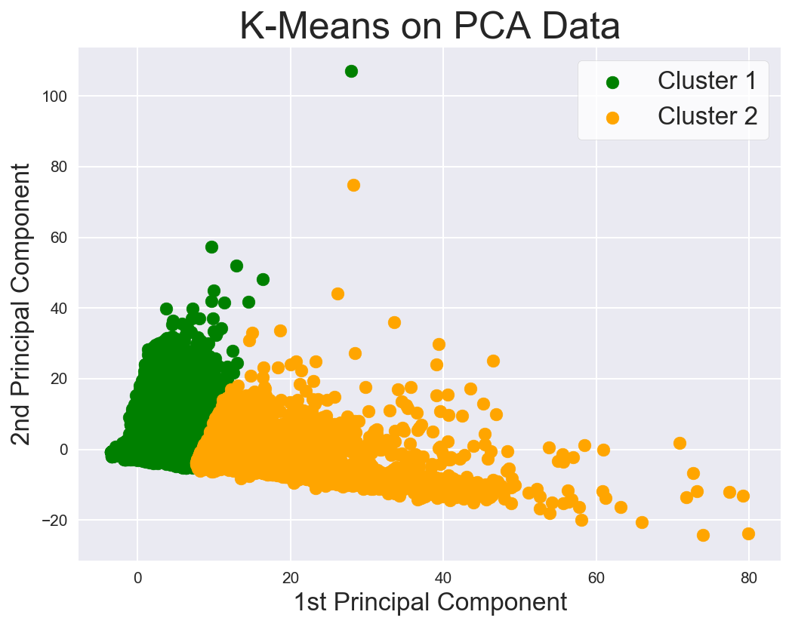

Slide 14
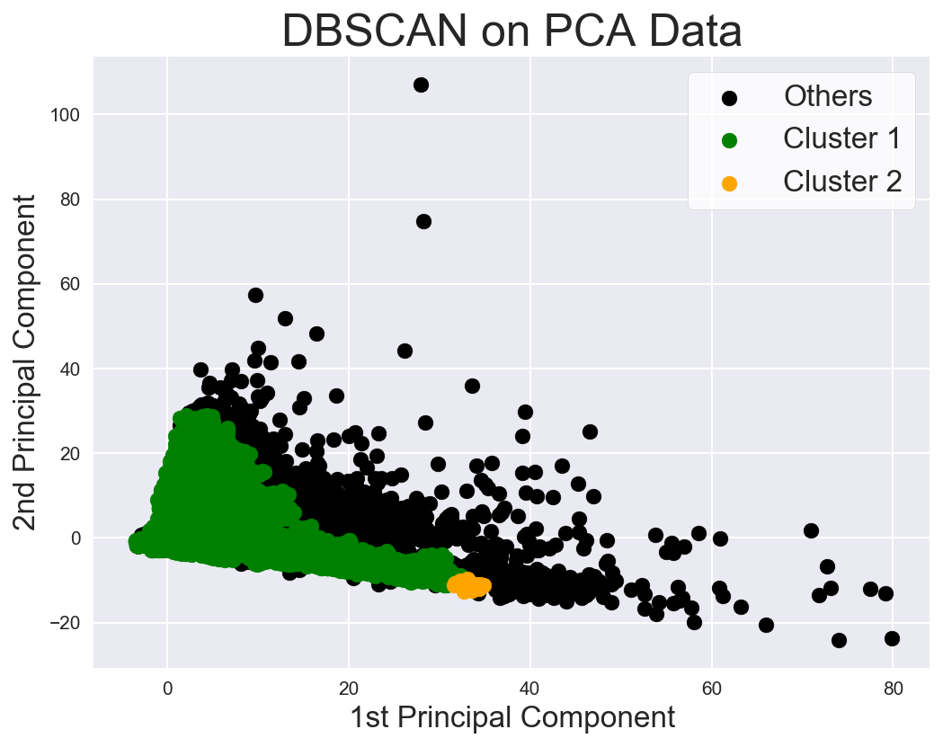

Slide 15
Simple Classification

Slide 16
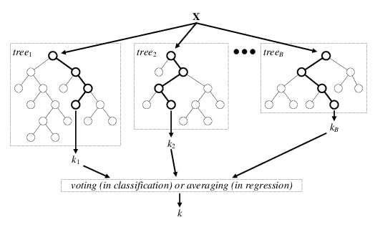
Random Forest (RF)
Lower variance (than regular decision trees)
Handles categorical features well
Good if some features are correlated

Slide 17
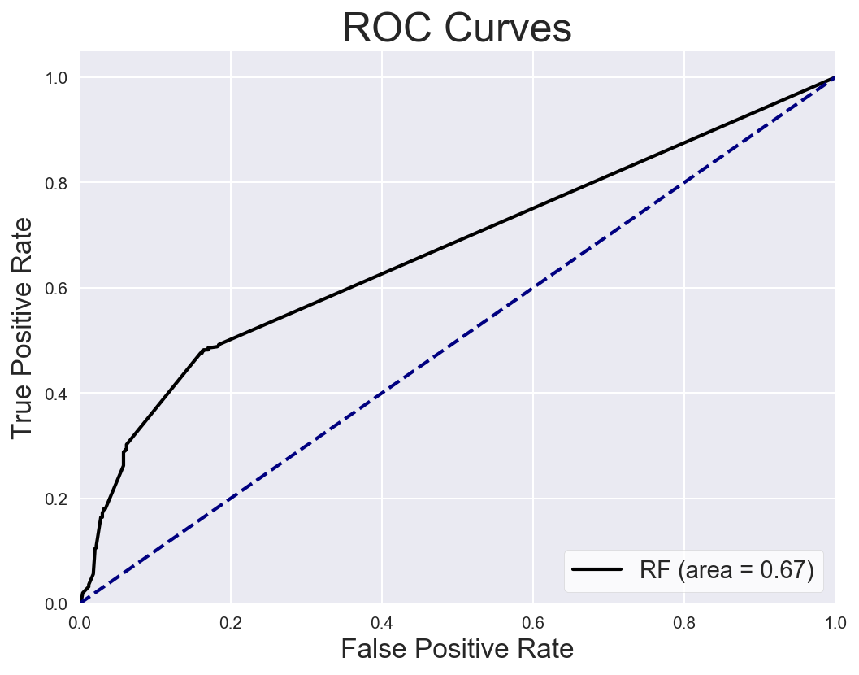

Slide 18
Why not use accuracy?
 |  | Prediction |  | Total
 |  | Positive | Negative
Truth | Positive | 90 | 10 | 100
 | Negative | 90 | 810 | 900
Total |  | 180 | 820 | 1000
True Positive Rate (TPR): 90 / 100 = 90%
False Positive Rate (FPR): 90 / 900 = 10%
Accuracy: (90 + 810) / 1000 = 90%

Slide 19
Why not use accuracy?
 |  | Prediction |  | Total
 |  | Positive | Negative
Truth | Positive | 10 | 90 | 100
 | Negative | 90 | 810 | 900
Total |  | 100 | 900 | 1000
True Positive Rate (TPR): 10 / 100 = 10%
False Positive Rate (FPR): 90 / 900 = 10%
Accuracy: (10 + 810) / 1000 = 82%

Slide 21
Over-sampling

Slide 22
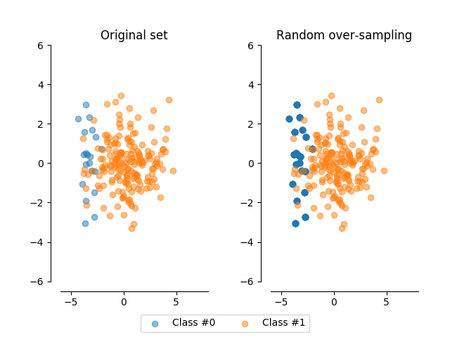
“Naïve” Over-sampling
Randomly duplicate data points from the smaller class
Equivalent to assigning class weights
Retrieved: http://contrib.scikit-learn.org/imbalanced-learn/stable/auto_examples/over-sampling/plot_random_over_sampling.html

Slide 23
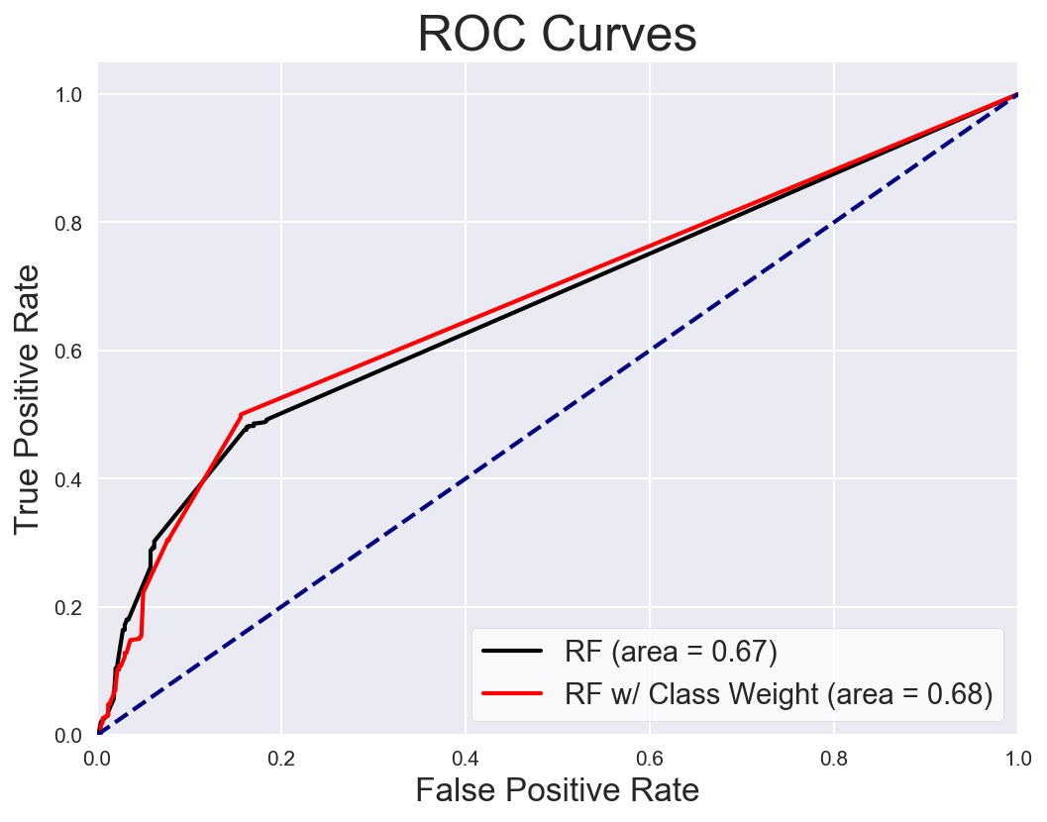

Slide 24
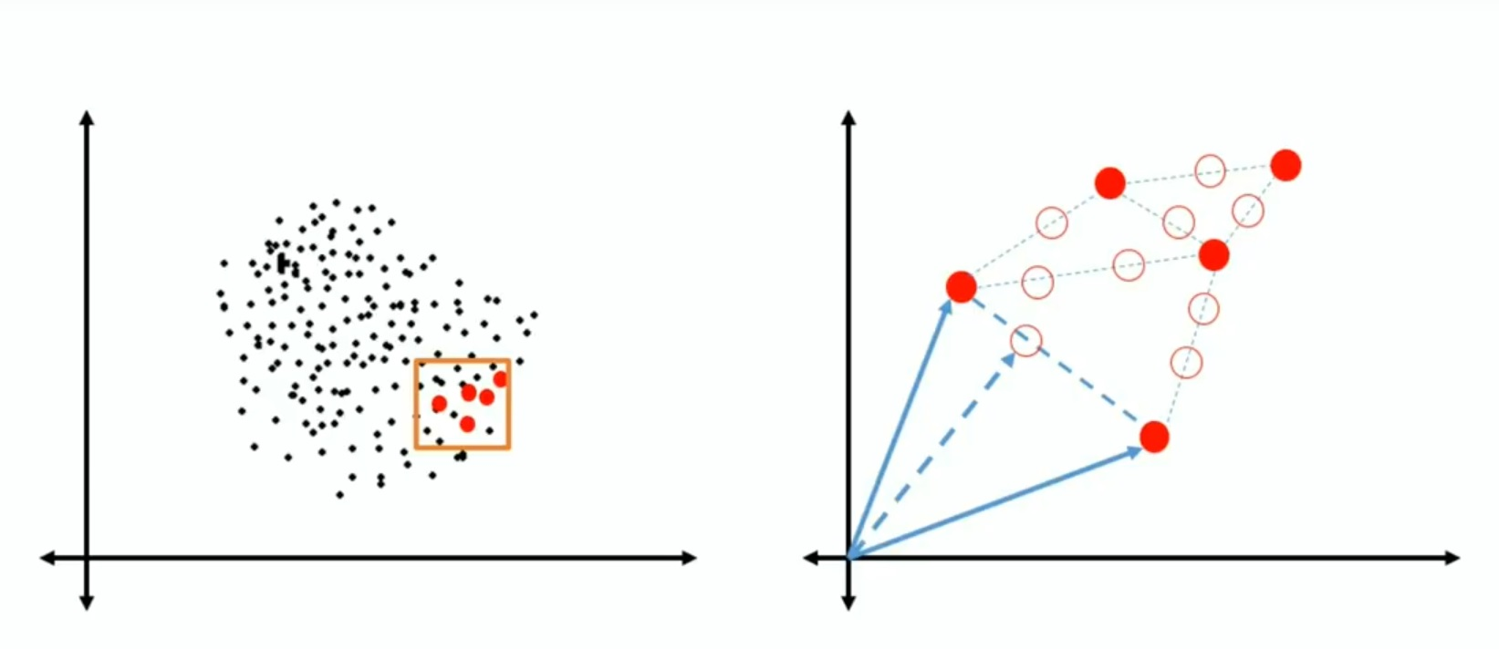
SMOTE (Synthetic Minority Over-sampling Technique)
Retrieved: https://www.youtube.com/watch?v=FheTDyCwRdE

Slide 25
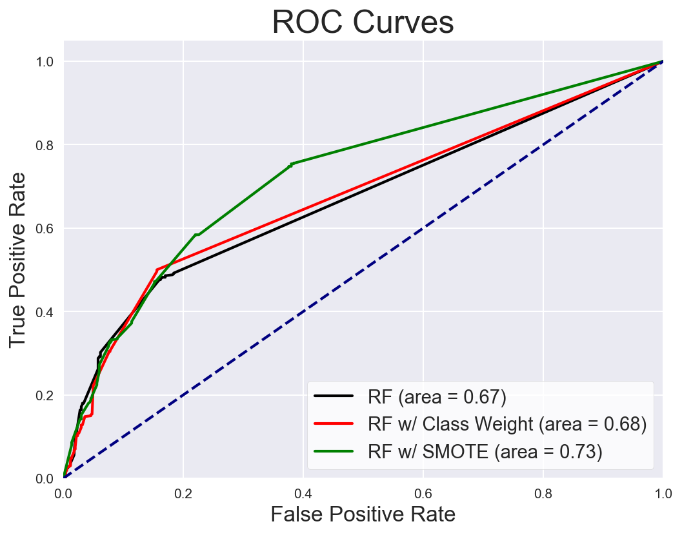

Slide 26
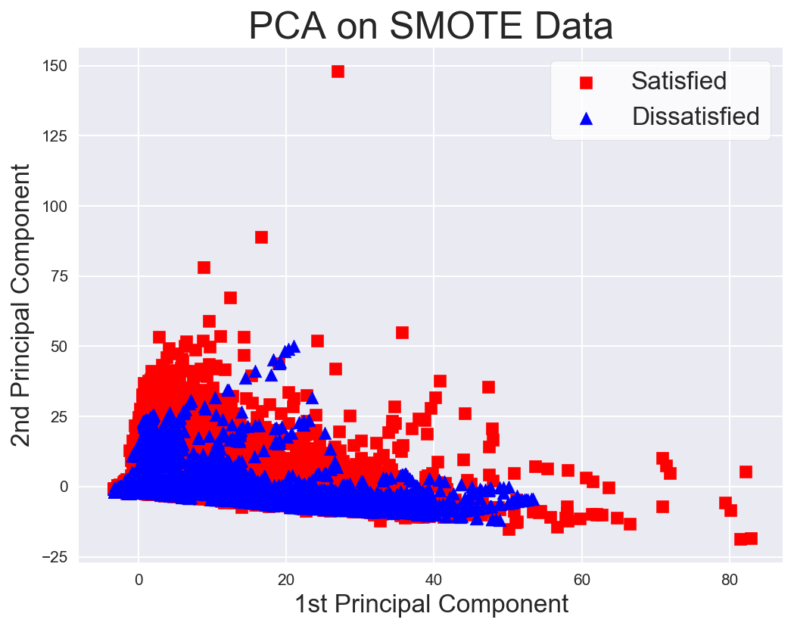

Slide 27
Under-sampling

Slide 28
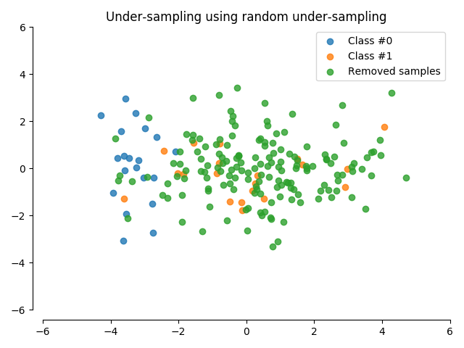
Random Under-sampling
Randomly remove samples from bigger class
Information lost!
Retrieved: http://contrib.scikit-learn.org/imbalanced-learn/stable/auto_examples/under-sampling/plot_random_under_sampler.html

Slide 29
“Ensemble” Under-sampling
Obtain 50 subsamples by under-sampling;
Train a model on each sub-sample;
Average the predictions

Slide 30
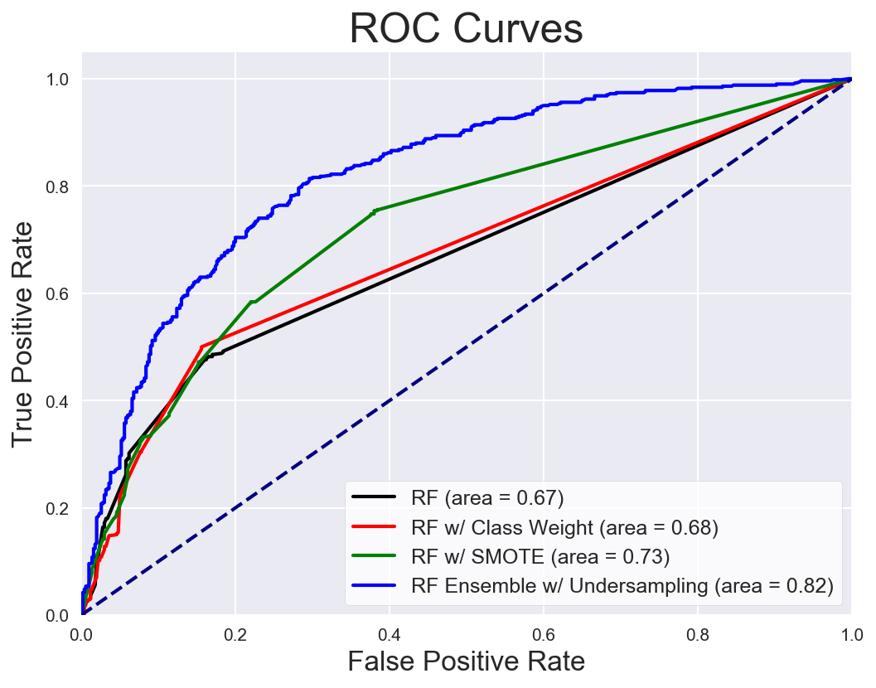

Slide 31
Gradient Boosting

Slide 32
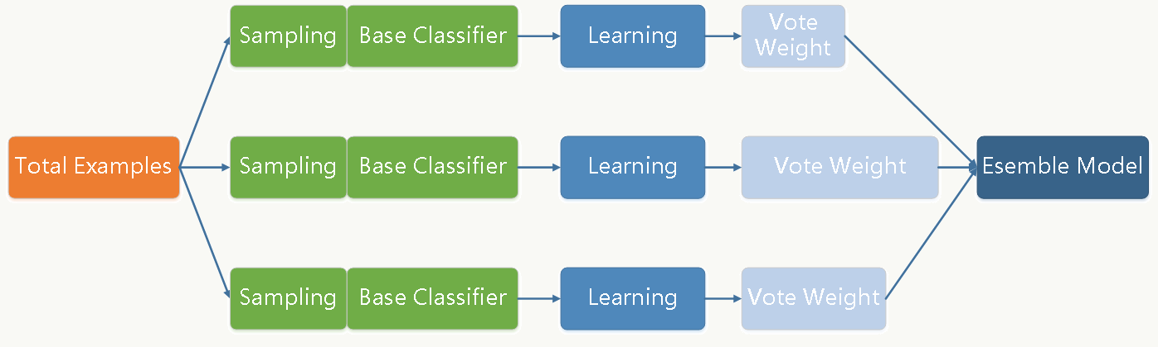
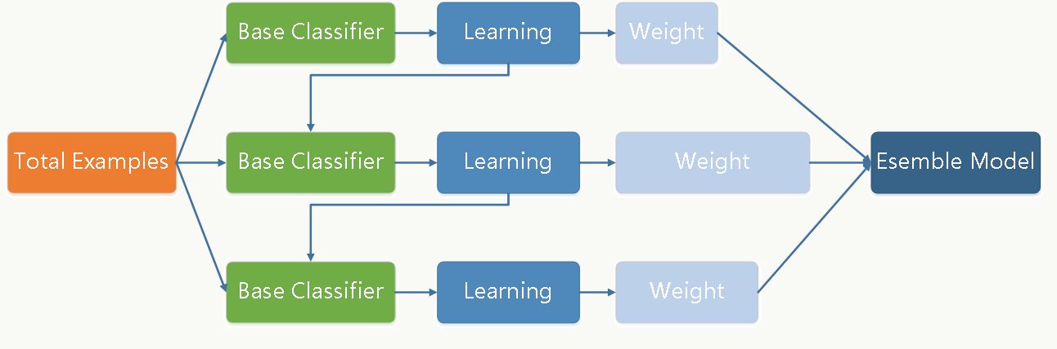
RF
GB

Slide 33
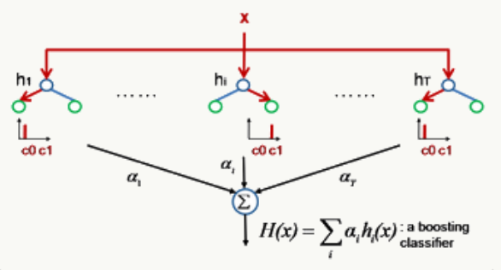
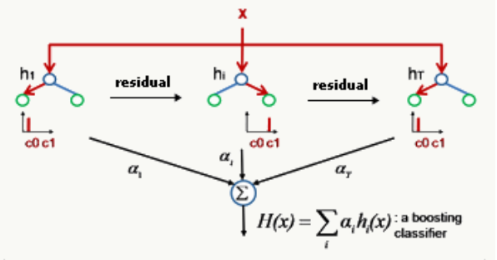
Random Forest
Gradient Boosting
Low Bias, High Variance
Low Variance, High Bias
Low Bias, Low Variance

Slide 34
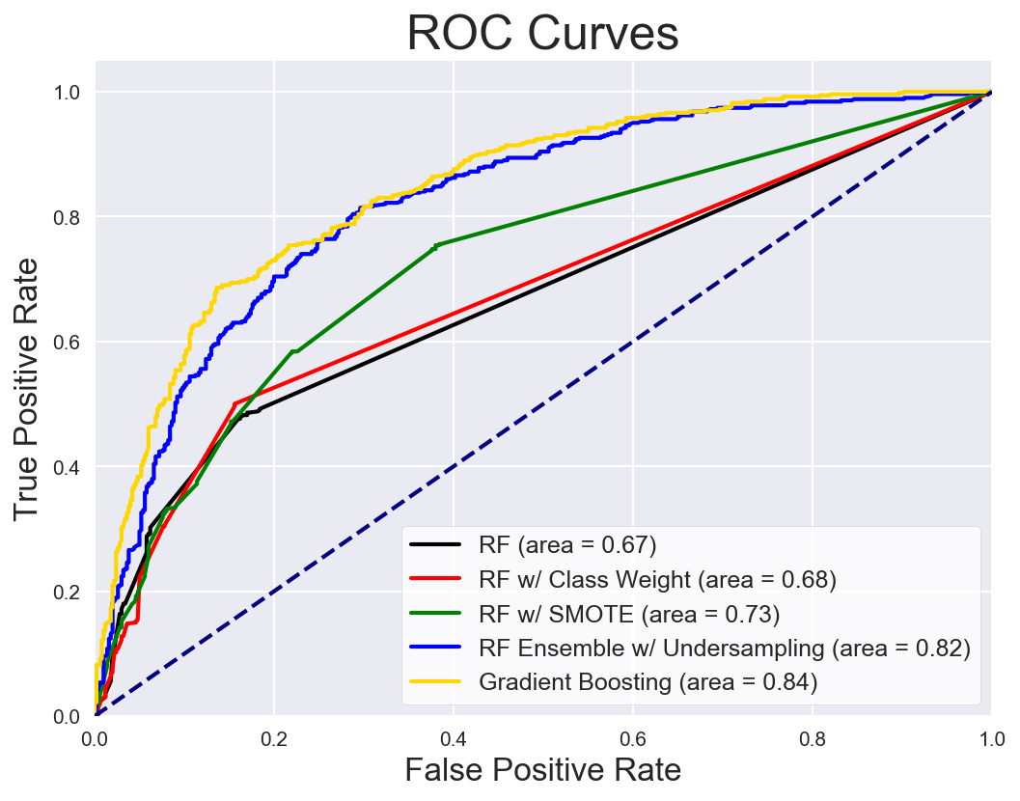

Slide 35
Conclusion
“Naive” over-sampling works poorly, SMOTE works slightly better.
Under-sampling with ensemble works significantly better, even without tuning.
Gradient boosting with tuning produces the best result.

Slide 36
Future Work – Other techniques
Other sampling techniques: ADASYN, etc.;
Feature selection;
Other models: SVM, Neural Networks, etc.

Slide 37
References
Ali A, Shamsuddin S M, Ralescu A L. Classification with class imbalance problem: A Review. 2015.
Santander Customer Satisfaction. Kaggle. Retrieved: https://www.kaggle.com/c/santander-customer-satisfaction
SMOTE - Synthetic Minority Oversampling Technique. Youtube. Retrieved: http://contrib.scikit-learn.org/imbalanced-learn/stable/auto_examples/over-sampling/plot_random_over_sampling.html
Random Over-Sampling. Imbalanced-learn. Retrieved: http://contrib.scikit-learn.org/imbalanced-learn/stable/auto_examples/over-sampling/plot_random_over_sampling.html
Random Under-Sampling. Imbalanced-learn. Retrieved: http://contrib.scikit-learn.org/imbalanced-learn/stable/auto_examples/under-sampling/plot_random_under_sampler.html
CS231n Convolutional Neural Networks for Visual Recognition. Stanford. Retrieved: http://cs231n.github.io/neural-networks-2/

